Slide 1
WEATHER PREDICTION
A.KARTHIK(221801023)
V.MAIYAZHAGAN(221801032)

Slide 2
INTRODUCTION
1.Real-Time Weather Updates: The application provides up-to-date weather information, including temperature, humidity, and wind speed, based on a user's city input.
2.User-Friendly Interface: Built with HTML, CSS, and JavaScript, the app features a clean and responsive design for seamless user interaction.
3.API Integration: The project uses the OpenWeather API to fetch real-time weather data, ensuring accurate and reliable results.
4.Dynamic Data Display: Weather conditions are dynamically displayed with corresponding icons, descriptions, and numerical data for an enhanced user experience.
5.Accessibility: The app is designed to be accessible on various devices, offering users an easy way to check the weather at any time and from any location.

Slide 3
EXISTING SYSTEM
Currently, most weather prediction systems offer basic weather information through mobile apps, websites, or weather services. These systems typically rely on external APIs to fetch weather data, which is then displayed in a static or dynamic format. However, the majority of these systems focus primarily on general forecasts without offering detailed or real-time data integration. They may also lack user-friendly interfaces and responsive designs across various devices. Existing systems often do not allow users to customize their search by city name or provide in-depth details such as wind speed or humidity. Many weather prediction systems also tend to provide limited data visualization, with few options for interacting with the weather details beyond a basic display of temperature. Our project aims to address these limitations by creating a more intuitive, dynamic, and user-centric system that displays real-time weather data in a visually engaging way, offering users a seamless and informative weather-checking experience.

Slide 4
EXISTING SYSTEM-DRAWBACKS
1.Limited Data Precision Existing weather prediction systems often provide general forecasts that lack real-time data precision. They might show a general weather pattern without details such as humidity, wind speed, or more granular temperature variations.
2.User Interface Complexity Many existing systems have cluttered or unintuitive user interfaces that make it difficult for users to quickly access relevant weather information. A poor UI design leads to a less engaging user experience.
3.Inadequate Customization Most systems provide limited customization options, such as being able to search only by city without offering advanced search features like region or country-based weather predictions.
4.Slow Data Updates Some weather prediction systems fail to provide real-time updates, displaying outdated information or showing updates with significant delays. This makes them unreliable, especially in rapidly changing weather conditions.

Slide 5
PROPOSED SYSTEM
The proposed weather prediction system aims to provide real-time, accurate weather data with a user-friendly, responsive interface. By utilizing the OpenWeather API, the system will fetch detailed weather information, including temperature, humidity, wind speed, and weather conditions, based on user input of a city name. The application will be built using HTML, CSS, and JavaScript to ensure a seamless, dynamic experience across various devices. It will feature a clean, intuitive interface that allows users to easily search for weather updates with minimal effort. Additionally, the system will be optimized for both desktop and mobile users, ensuring accessibility and usability. Error handling will be incorporated to manage cases like incorrect city names or network issues. The system will provide real-time updates, reducing delays in weather data delivery. With this, the proposed system aims to offer a more comprehensive, accessible, and responsive weather prediction tool compared to existing solutions.

Slide 6
PROPOSED SYSTEM-ADVANTAGES
API Integration for Accuracy: By leveraging the OpenWeather API, the system ensures access to reliable and accurate weather forecasts from a trusted source, enhancing the credibility of the data.
Error Handling and Robustness: The proposed system includes comprehensive error handling, allowing it to manage user input errors (e.g., incorrect city names) and API connection issues, improving overall reliability.
Mobile and Desktop Optimization: The system is fully optimized for various screen sizes, ensuring that the app functions well across both mobile and desktop devices without compromising usability.
Customization Features: The system allows users to search for weather updates based on city input, offering a tailored experience for individuals seeking specific weather information.
Faster Performance With optimized backend and frontend interactions, the proposed system reduces latency, providing faster access to weather data and improving the overall performance of the application.

Slide 7
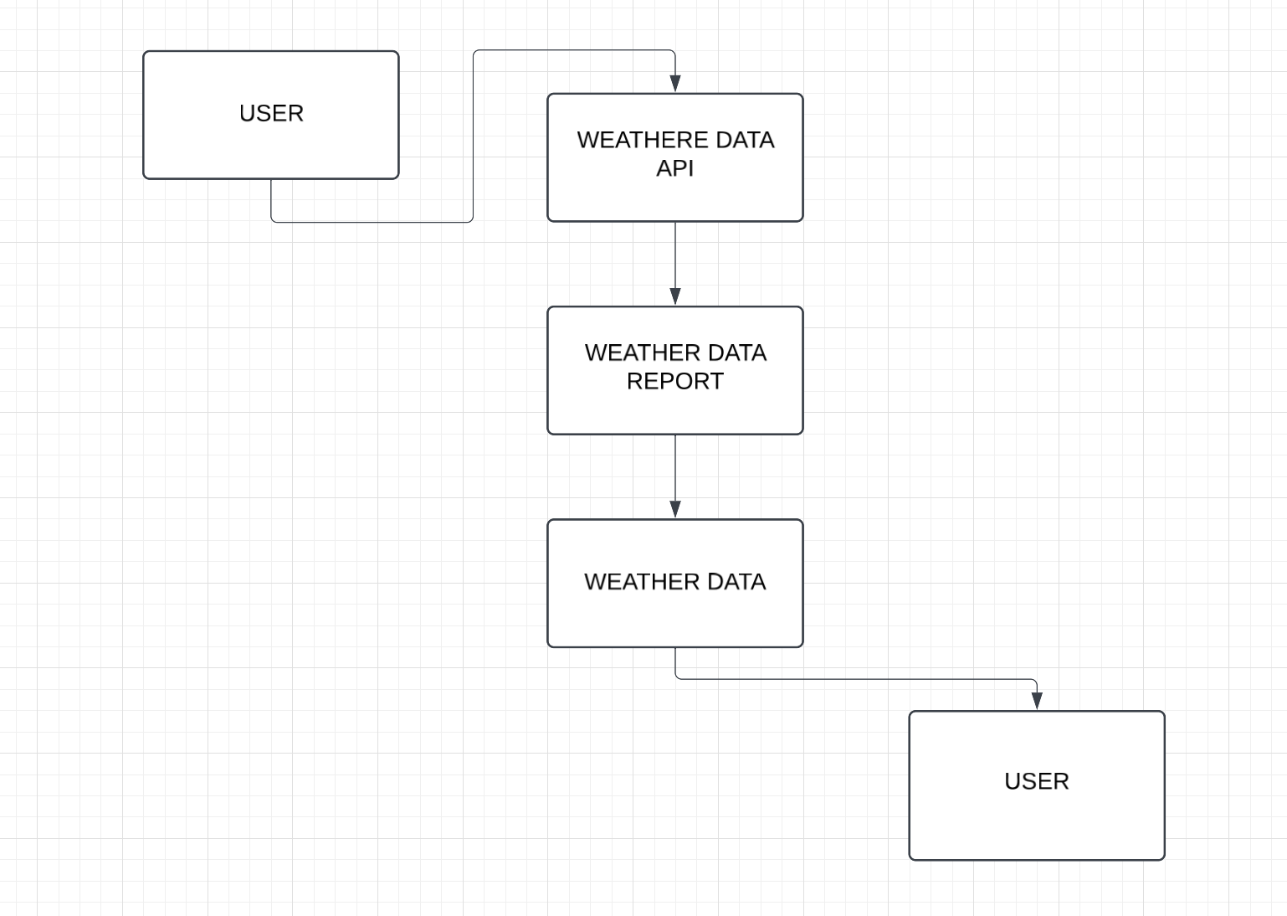
DATA FLOW DIAGRAM

Slide 8

MODULES
User Input Module This module is responsible for receiving the user’s input, specifically the name of the city for which the weather information is required. The user enters the city name into a search bar, and the module validates the input to ensure it is not empty and is a valid city name before proceeding to fetch data.
Weather Data Fetching Module Once the user enters the city name, this module connects to the OpenWeather API to fetch real-time weather data. The module constructs the appropriate API request, sends it to the server, and processes the returned data, extracting relevant weather details like temperature, humidity, wind speed, and weather conditions.
Data Processing and Display Module After receiving the weather data, this module processes and formats the data for display. It converts the fetched data into a readable format (e.g., temperature in Celsius) and dynamically updates the user interface with the weather details, such as displaying weather icons, temperature, and descriptions.
Error Handling and User Feedback Module This module manages any errors that may occur during the user input or data fetching process. It handles invalid city names, API errors, or network issues and provides appropriate feedback to the user, such as "City not found" or "Unable to fetch weather data." This ensures the application remains user-friendly and reliable.

Slide 9
AGILE MODEL
The Agile model is implemented in the weather prediction project to ensure iterative development and continuous improvement. With Agile, the project is divided into small, manageable tasks, allowing for regular updates and quick adjustments based on user feedback. Each iteration focuses on delivering functional features, enabling faster development cycles and more responsive updates. This approach ensures that the system meets the requirements effectively, with regular communication among team members and stakeholders. Agile promotes flexibility, collaboration, and a high level of user involvement throughout the project lifecycle.
1.Planning The project requirements are discussed, and initial planning is done for the first iteration. High-level goals and user stories are defined to outline the features and tasks.
2.Design and Development During this phase, the development team works on the design and builds the core features of the weather prediction system. The design is flexible, allowing modifications based on ongoing feedback.
3.Iteration/Increment The development is done in small iterations or sprints, typically lasting 1-4 weeks. Each sprint delivers a functional piece of the system, such as weather data fetching or UI enhancements.
4.Testing and Feedback At the end of each iteration, the system is tested for bugs, performance issues, and usability. User feedback is gathered to ensure that the system meets user needs and expectations.

Slide 10
UNIT TESTING
Objective: Unit testing ensures individual components of the system function correctly and independently.
Tools: Common tools for unit testing include Jest, Mocha, and Chai.
Example: Testing the function that fetches weather data to ensure it returns correct values for valid city names.In unit testing, we test individual functions to ensure they work correctly. For example, in a weather prediction app, the get Weather Data(city) function fetches the weather for a given city. The unit test checks if this function correctly returns the expected temperature value by mocking the API response. This ensures that the function behaves as expected without needing to make an actual API call.

Slide 11
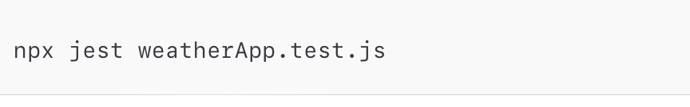
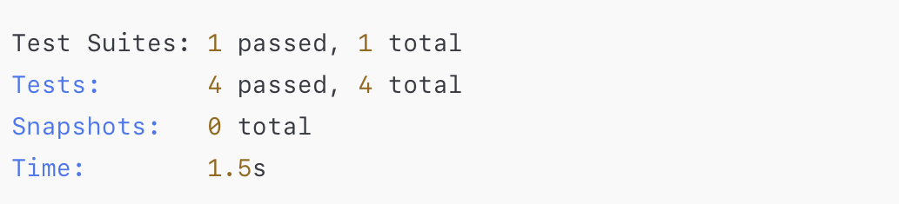
TESTING OUTPUT

Slide 12
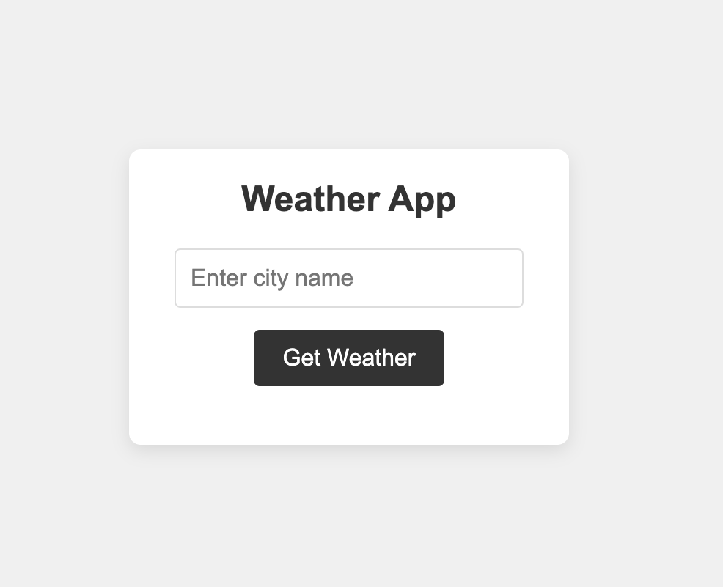
OUTPUT

Slide 13
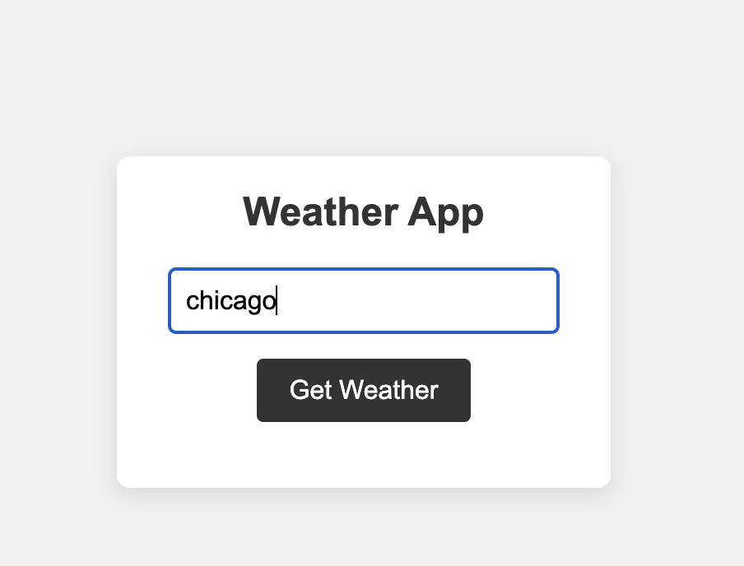

Slide 14
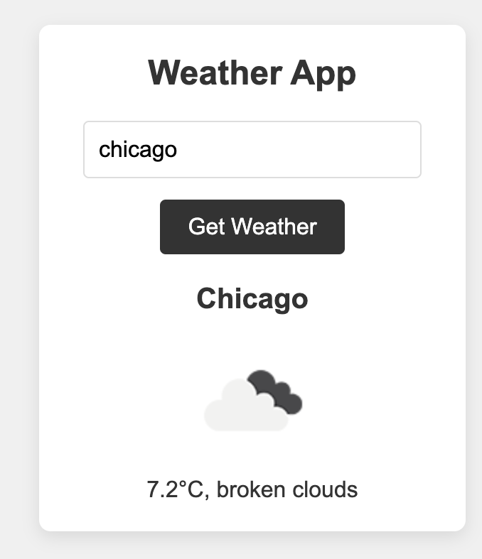

Slide 15
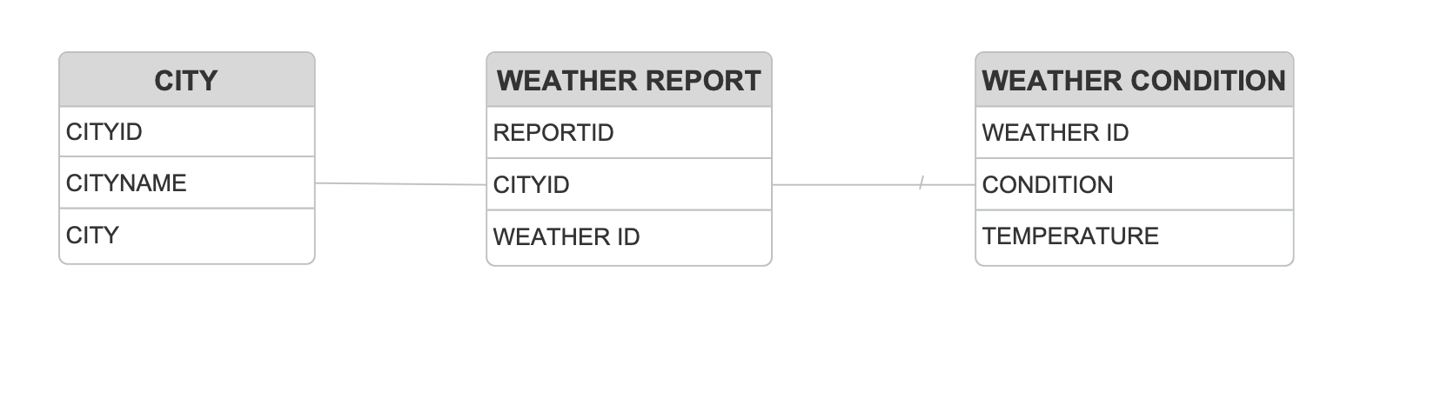
ENTITY RELATIONSHIP DIAGRAM

Slide 16
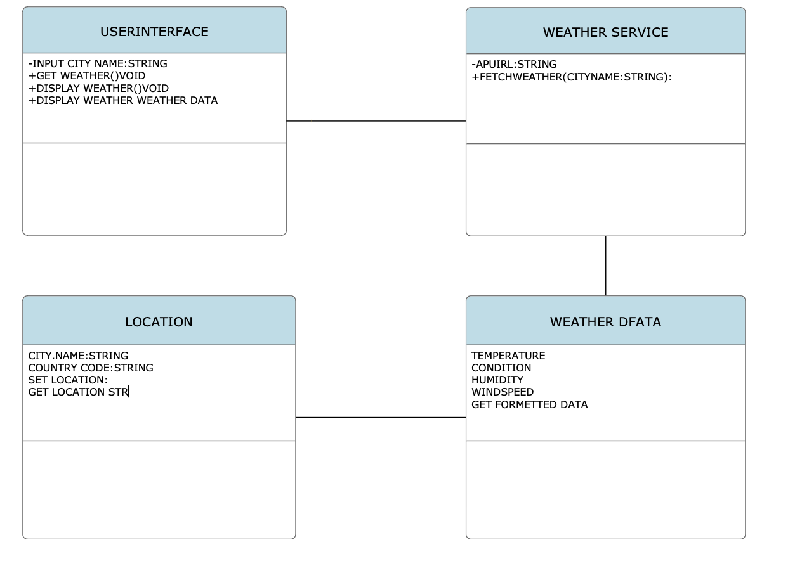
UML DIAGRAM

Slide 17
CONCLUSION
In conclusion, our weather prediction app provides users with a robust and reliable source of weather information, combining real-time data from multiple sources with powerful predictive algorithms. This app empowers users with immediate weather updates and forecasts, helping them make informed decisions for both daily activities and long-term planning.The app’s customizable features, such as location tracking and alert settings, offer a tailored experience that meets diverse user needs. These personalization options enhance usability, making it easy for users to stay informed and prepared for any weather conditions.

Slide 18
REFERENCE
HTML Official Documentation
World Wide Web Consortium (W3C) HTML Specification: This is the official documentation on HTML, providing comprehensive details on elements, attributes, and best practices for structuring web content.
URL: https://www.w3.org/TR/html52/
CSS Official Documentation
W3C CSS Specification: This provides an official guide to CSS properties, values, and guidelines, which will help in styling and designing responsive, visually appealing web pages.
URL: https://www.w3.org/Style/CSS/
JavaScript.info
This site provides in-depth tutorials and explanations covering both fundamental and advanced JavaScript concepts. It’s a highly regarded resource for building a strong foundation in JavaScript, with practical examples for each topic.
URL: https://javascript.info/

